Slide 1
Strategic Information Systems
CIS 150: Fundamentals of Information Systems

Slide 2
A Brief Recap
Course Administration
  Course intranet site (Blackboard or simply BB)
    https://blackboard.louisville.edu/webapps/login
  Syllabus and Schedule
    BB > Course Information
  Meet Your Professor
    BB > Course Information
  Student Survey
Course Introduction
  I.T. Benefits
  Risks
  Controversies

Slide 3
A Brief Recap
Computers and IS are everywhere
  They help people solve problems and make decisions
Some questions you should be able to answer
  What is a system?
  What is an information system (IS)?
  What is the purpose of an IS?
  What are examples of some common IS?
  What new opportunities for IS are developing today and what is driving these new opportunities?
  What are some important ethical dilemmas created by IS today?

Slide 4
Some Interesting Questions
What is competitive advantage?
Who is Porter and what are the Five Forces?
How do companies gain competitive advantage?
  8 commons ways
What are “newly vulnerable markets”?
  Markets where small, nimble new entrants are able to successfully attack established incumbents (with IS)
  Markets that are newly easy to enter, attractive to attack, and difficult to defend

Slide 5
Strategy
Business strategy
  a plan to outperform competitors by creating or exploiting new opportunities
Strategic information system
  IS that creates and seizes opportunities
  Helps an organization achieve competitive advantage through better business decisions
Competitive Advantage
  Gains higher profit margins
  Gains higher market share

Slide 6
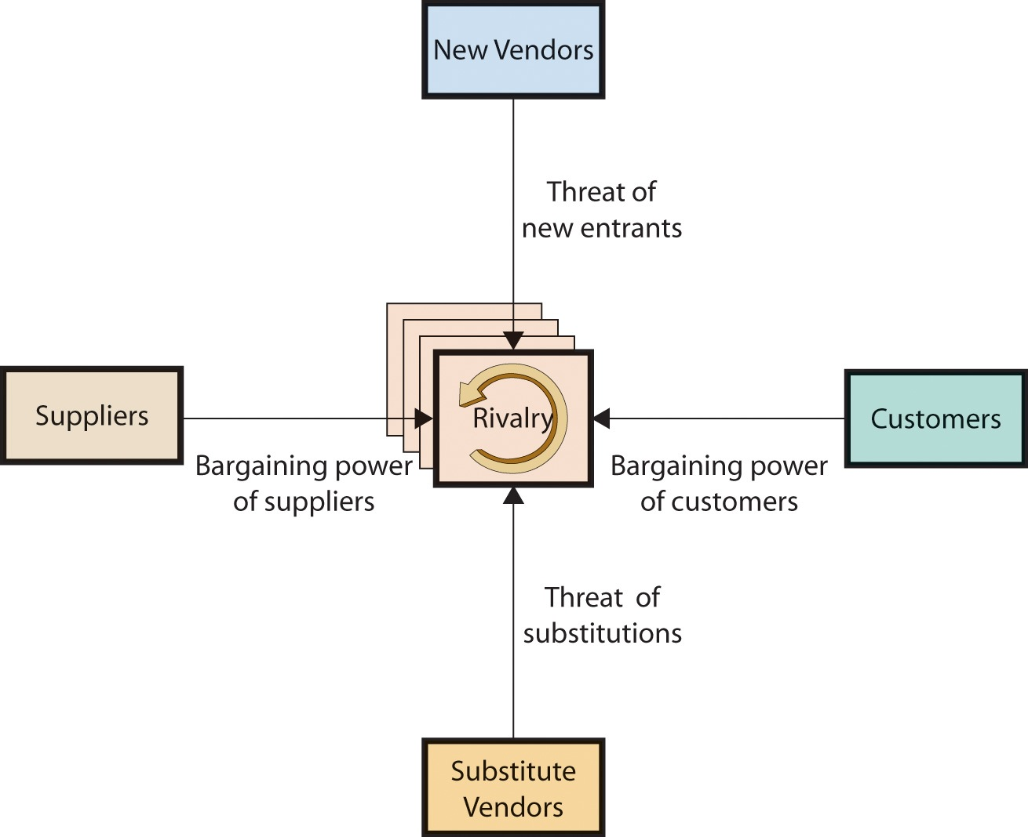
Porter’s Five Forces
Figure 3-2
3-<number>

Slide 7
Achieving Competitive Advantage
Reduce cost… reduce price, sell more units, gain market share and increase profit margin
Raise barriers to market entrants… reduces competition
Establish high switching costs… keeps customers
Create new products/services… first mover advantage, unique offering
Differentiate products/services… attracts customers
Enhance products/services… better quality and value to customers
Establish alliances… cross-industry synergy
Lock in suppliers/buyers… bargaining power

Slide 8
Reduce Cost
Companies that lower their production costs
  Lower costs → lower prices → increase market share
  If you lower prices a little less than you lower costs → increase profit margins (price minus unit cost)
How can IS help significantly lower costs?
  Automating business processes
    Internet and customer service
      Online banking, travel, package tracking, FAQs
    Internet and product/service distribution
      Online music, software, sales (Amazon.com), advertising

Slide 9
Raise Barriers to Market Entrants
Having fewer competitors is usually better
  Try to make it difficult and expensive for companies to make the products that you make
What are some barriers?
  Technology and expertise
    Superior IT infrastructure and people
  Legal protections
    Patents
      Priceline’s “Name Your Own Price” patent
      Amazon.com’s “One-Click Purchasing Technology” patent)
    Copyright protections
    Trade secret laws

Slide 10
Establish High Switching Costs
Switch costs (SC)
  Are incurred when a customer stops buying from one company and starts buying from another company
Explicit SC
  Costs and fees a company charges its customer for switching to another company
    e.g., cell phone companies, mortgage companies
Implicit SC
  Time and money you spend adjusting to the new product or service
    e.g., switching from MAC to PC, switching from Amazon.com to BN, switching classes in Week 3 of a semester, laser ink-jet printers, cell phone example

Slide 11
Create New Product/Services
Self-explanatory
  If you create a new product that people want and you are the first to do it, you will have a competitive advantage until another company figures out how to copy it
    E-bay (online auctions)
    VisiCalc (the first electronic spreadsheet)

Slide 12
Differentiate Products/Services
This is about persuading customers that your product is better that the competitors’ products
  A perceived difference (through advertising) - Exemplified by brand name recognition
    “Can you hear me now?”
    "Plop, plop, fizz, fizz, oh what a relief it is!“
    "You're in good hands with ??????."
    "Membership has its privileges" and "Don't leave home without it“
    “What’s in your wallet?”
    “The Ultimate Driving Machine”
    "We try harder."
    “The quicker picker-upper.”
    "When you care enough to send the very best"
Notes:
Verizon
Alka-Selzer
All-State Insurance
American Express
Capital One
BMW
Avis (rent-a-car)
Bounty towels
Hallmark

Slide 13
Enhance Products/Services
Offer better products or perhaps services that customers are willing to pay higher prices for
  What are some examples?

Slide 14
Establish Alliances
Many companies bundle their products and services to make them more attractive to customers (or to lower costs)
Examples
  Amazon.com
    Books, music, online auction, electronics, etc.
  Wal-Mart
    Books, music, clothes, electronics, grocery, pharmacy, etc.
  Travelocity
    Airline, hotel, rental car, etc.
  Credit card companies
    Reward programs (frequent flier miles, hotels, restaurants, grocery stores, gas, etc.)
  HP and Federal Express
  Target.com and Amazon.com
  Cross-advertising on websites

Slide 15
Lock-In Suppliers/Buyers
A common example is when a major corporation uses its size to gain bargaining power
Examples
  Wal-Mart
  Adobe
    Why do they give Adobe Reader or Flash Player away for free?
    They want to get everyone on the Internet to use them so companies will create content using their authoring tools (which can then be read by customers that have the free Readers and Players)

